Slide 1
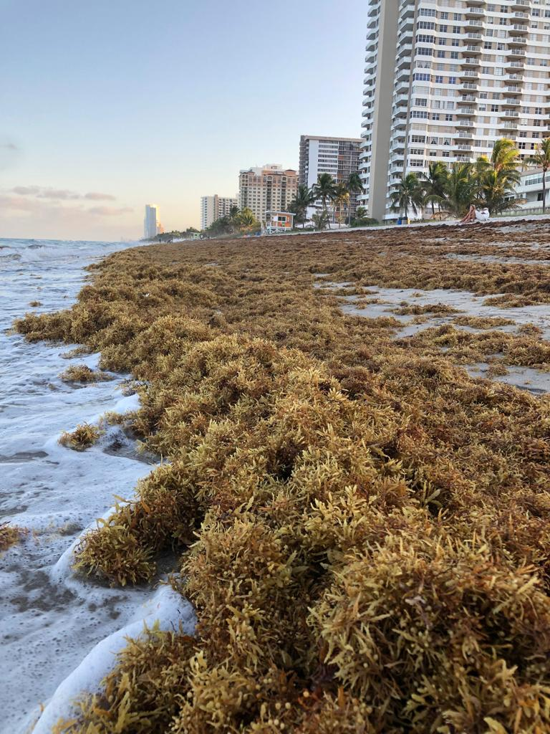
PIONEERING A CITIZEN SCIENCE APPROACH TO MONITOR LANDINGS OF PELAGIC SARGASSUM
Lowell Andrew R. Iporac, Ph.D Candidate
Marine Macroalgae Research Lab (MMRL)
Mentor: Dr. Ligia Collado-Vides
Florida International University

Slide 2
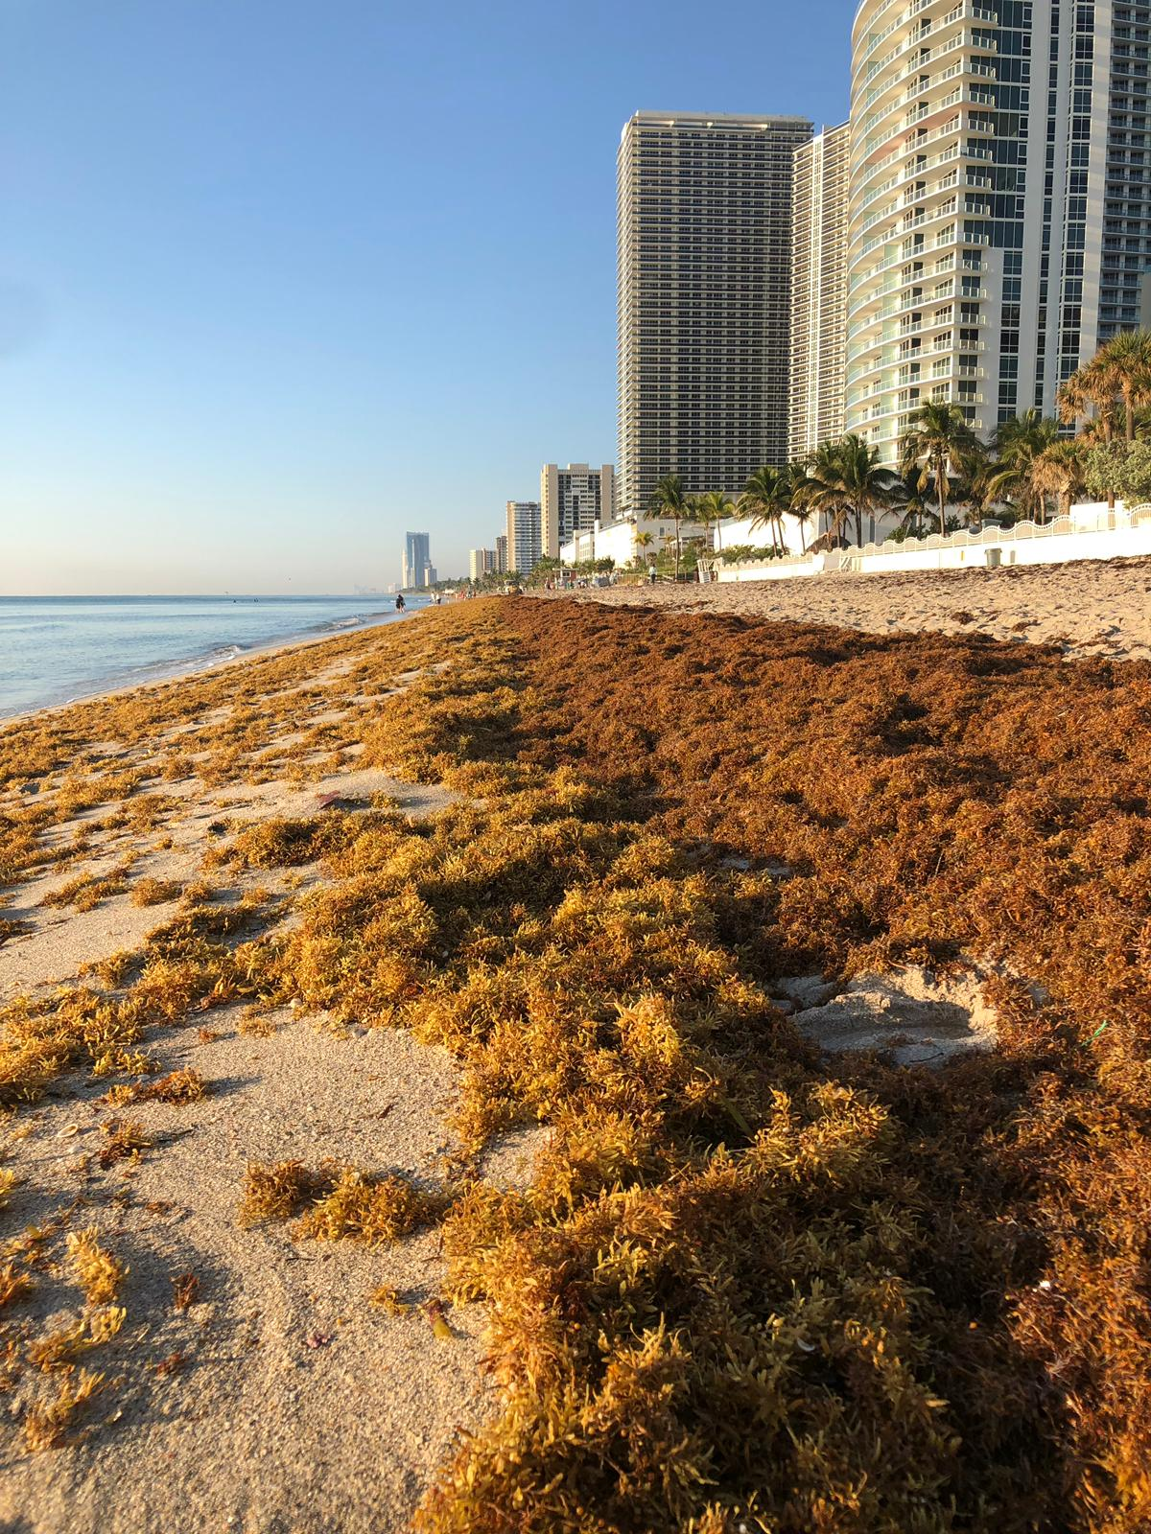
Let me introduce you to…….
Pelagic Sargassum!
Source: Schell, J., Goodwin, D. & Siuda, A. 2015. Recent Sargassum Inundation Events in the Caribbean: Shipboard Observations Reveal Dominance of a Previously Rare Form. Oceanography. 28:8–10.
Notes:
Ask why we need to have citizen science! Ground-proof remote sensing & monitoring.

Slide 3
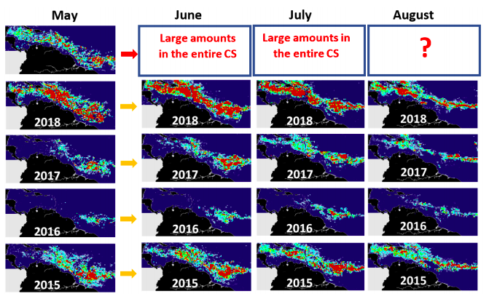
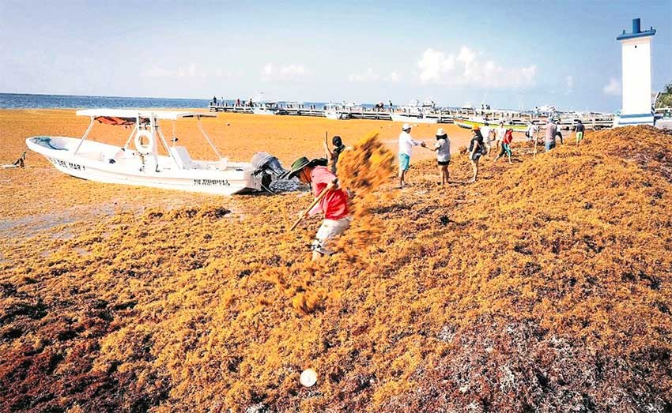
Since 2011, severity of Sargassum depends on geographical location
This regional problem is challenging existing local monitoring and satellite modelling programs. Citizen science can help ground-truth the models’ large geographical scope.
Source: Sargassum Watch System (SaWS, Florida State Univ.)
Quintana Roo, MX August 2018
Hallandale Beach, FL USA, July 2018
Notes:
This regional problem is challenging monitoring programs

Slide 4
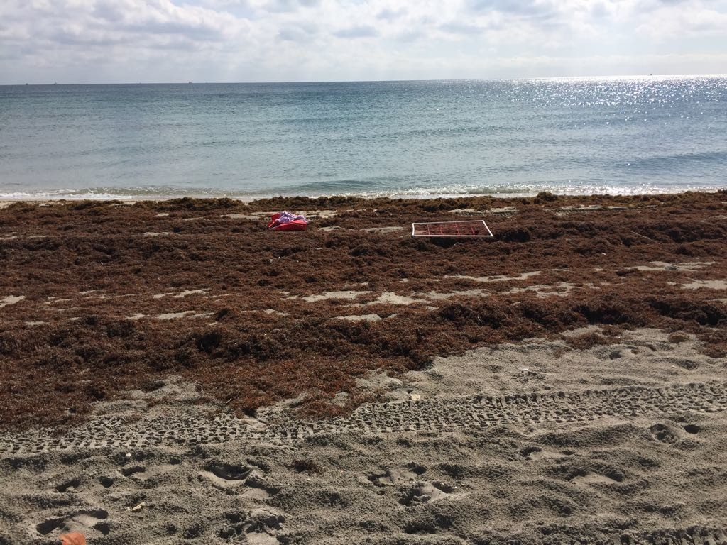
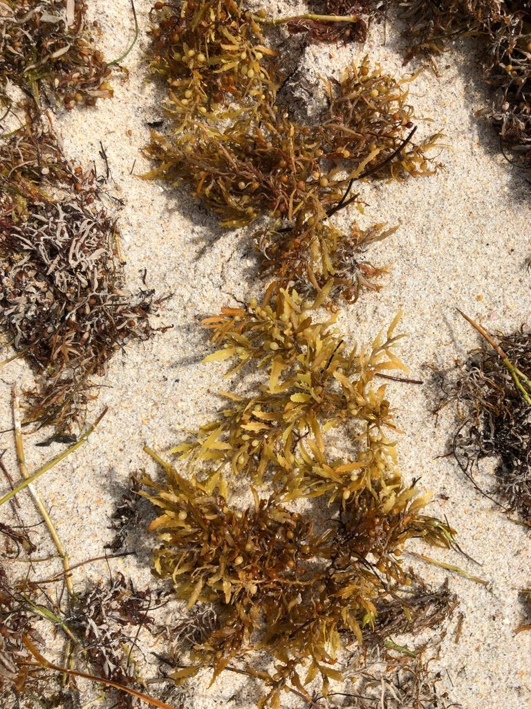
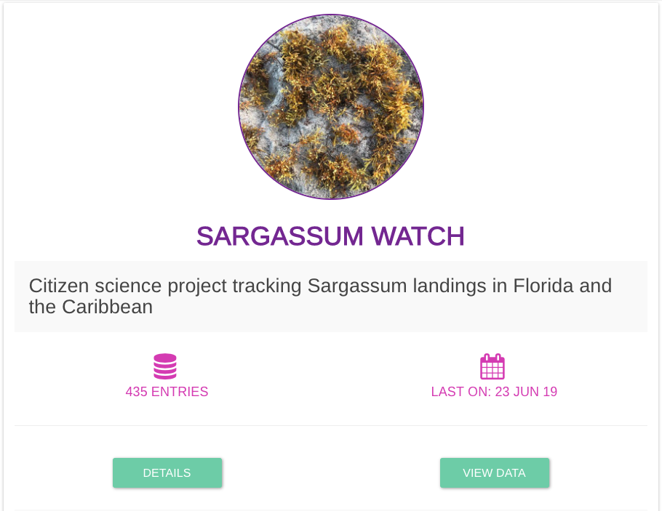
On-site observation
Epicollect5
(FREE mobile app for in situ observations)
OPEN Database
Notes:
Anyone can download the app!

Slide 5
Very high Sargassum
As of today, over 430 observations!.... > 99% of it from South Florida
High Sargassum
Moderate Sargassum
Low Sargassum
Very low Sargassum
(Accumulation categories from Dr. Marta García-Sánchez, and Dr. Brigitta van Tussenbroek, UNAM)

Slide 6
Very high Sargassum
High Sargassum
Moderate Sargassum
Low Sargassum
Very low Sargassum
(Accumulation categories from Dr. Marta García-Sánchez, and Dr. Brigitta van Tussenbroek, UNAM)

Slide 7
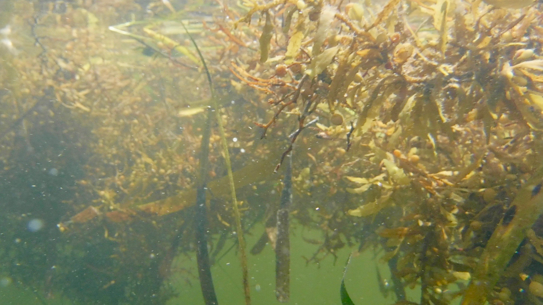
Join the International Sargassum Network (SargNet)
Interested in my citizen science project and/or Sargassum?

