Slide 1
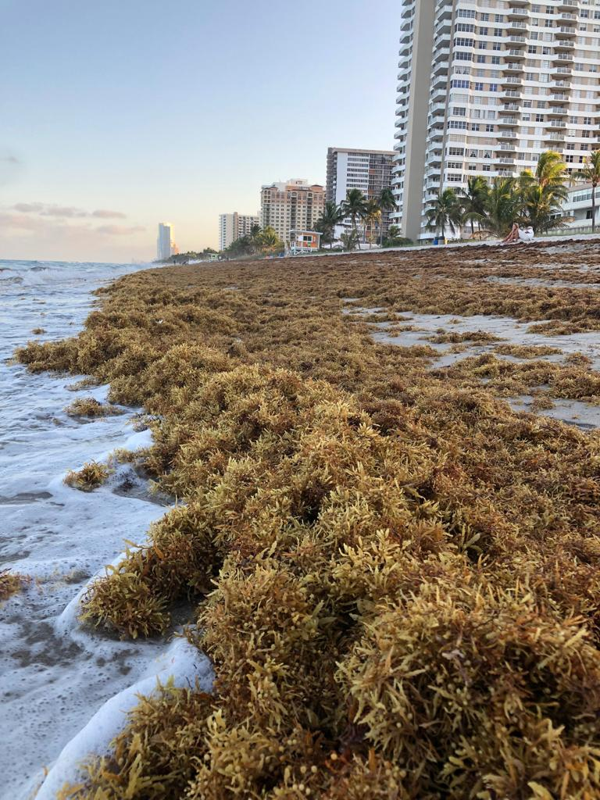
Lessons and challenges in piloting a citizen science project to monitor pelagic Sargassum landings in South Florida
Lowell Andrew R. Iporac
Dr. Ligia Collado-Vides
Dr. Derek Burkholder

Slide 2
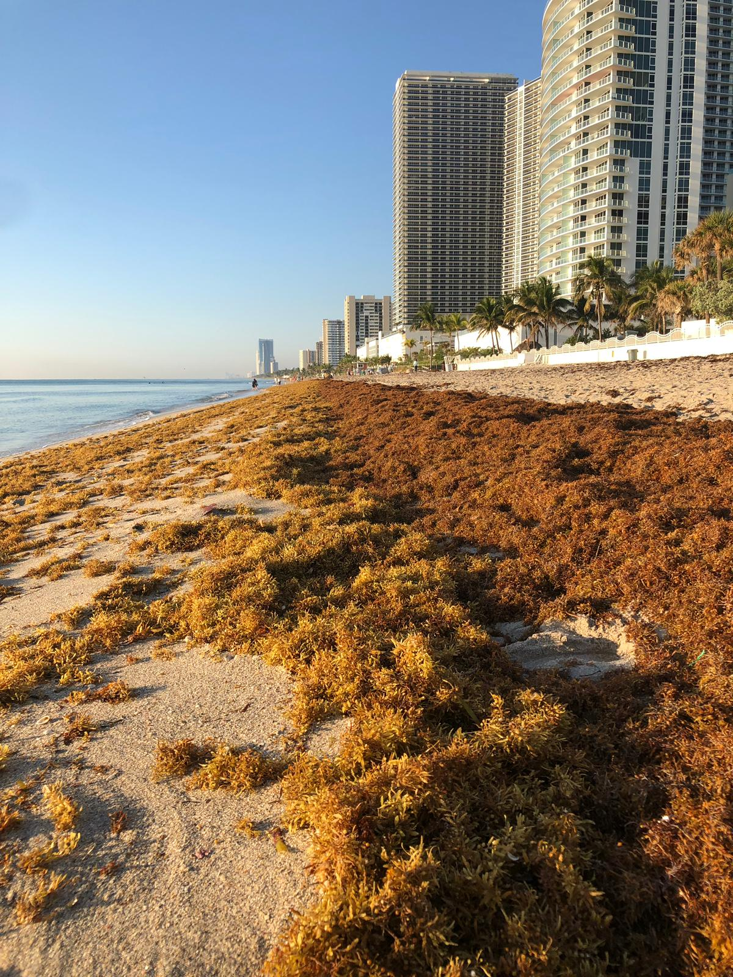
Let me introduce you to…….
Pelagic Sargassum!
Source: Schell, J., Goodwin, D. & Siuda, A. 2015. Recent Sargassum Inundation Events in the Caribbean: Shipboard Observations Reveal Dominance of a Previously Rare Form. Oceanography. 28:8–10.

Slide 3
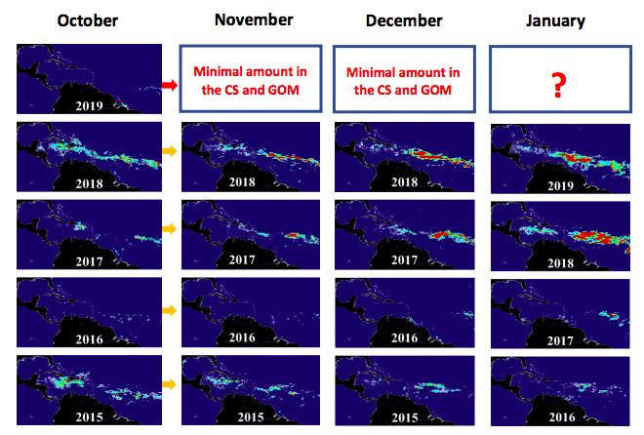
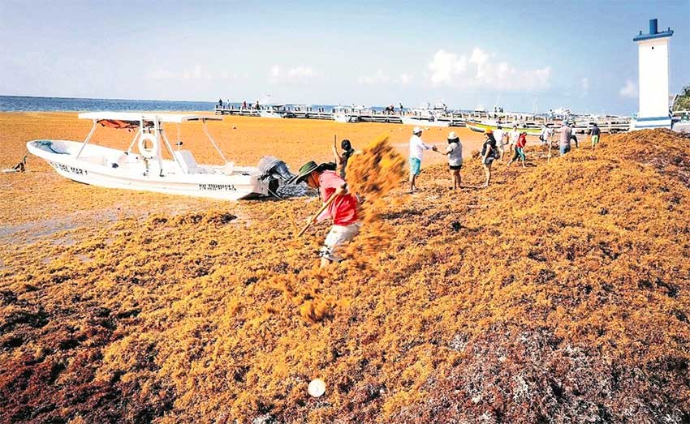
Since 2011, severity of Sargassum varies on geographical location
This regional problem is challenging existing local monitoring and satellite modelling programs. Citizen science can help ground-truth the models’ large geographical scope.
Source: Sargassum Watch System (SaWS, Florida State Univ.)
Quintana Roo, MX August 2018
Hallandale Beach, FL USA, July 2018

Slide 4
Objectives
Determine the best strategy for executing the citizen science program “Sargassum Watch”.
Identify challenges in executing a citizen science program of a large scale.
Identify potential collaborators for expanding the citizen science initiative.

Slide 5
Timeline of our program development
WhatsApp/CitSci Approach
Epicollect5/ Target Group Approach
August 2018
April 2019
Present

Slide 6
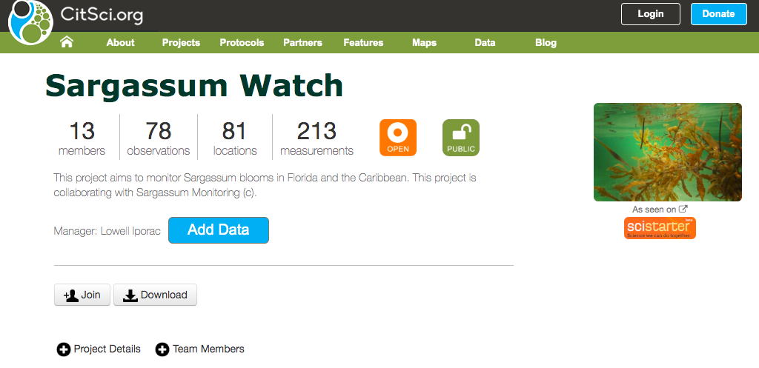
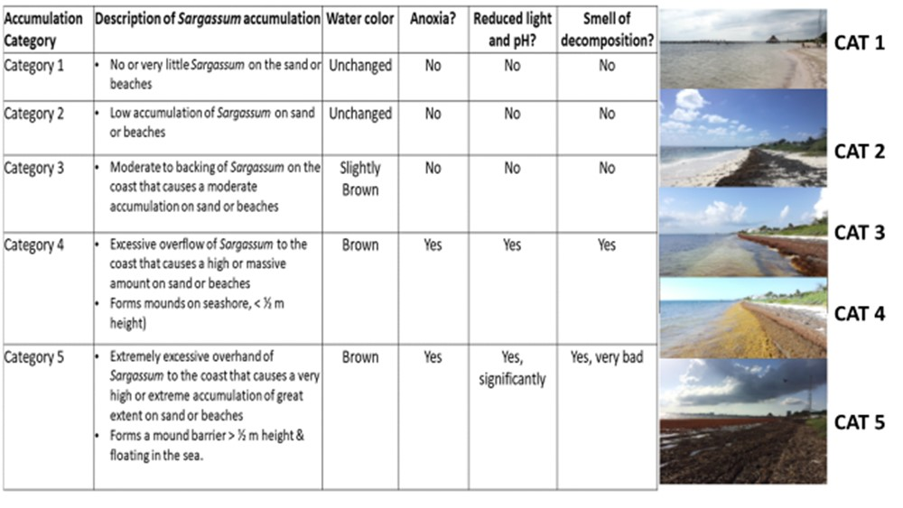
Initial Approach: WhatsApp/CitSci Approach
Photo
Email/WhatsApp
Data collected:
Time
Location
Level of Accumulation (based on Collado-Vides et al. 2018)
(Species (if applicable)

Slide 7
This approach gives us a broader geographic view, but the processing of data is very inefficient

Slide 8
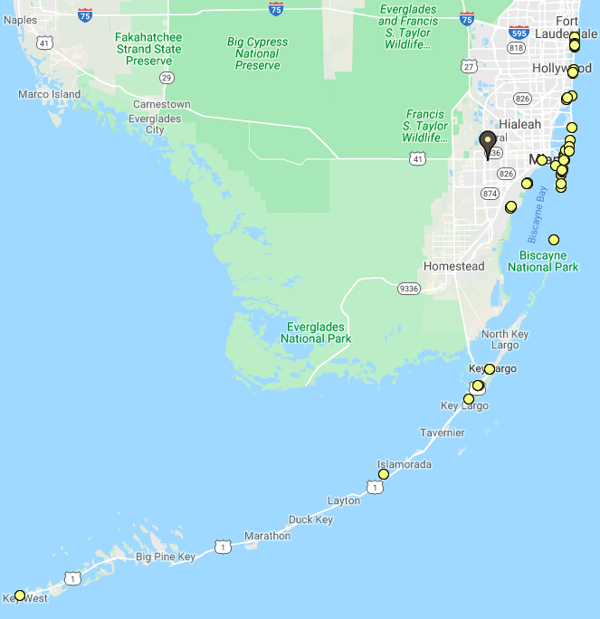
Notes:
Include time zone at that level of analysis, S. florida is not heavily impacted

Slide 9
WhatsApp-CitSci Approach Effective in generalizing a single geographical location, but frequency of data collection is poor. The CitSci App is also user-unfriendly

Slide 10
We need a user-friendly citizen science app...

Slide 11
…… And we need target groups to use the app!
Name: Broward County Sea Turtle Conservation Program
Start Date: April 2019
Frequency: Daily
No of Sites: 9
Name: Miami Waterkeepers
Start Date: August 2019
Frequency: Weekly
No. of Sites: 4
Name: Deering Estate
Start Date: August 2019
Frequency: Weekly
No of Sites: 1
Notes:
Reduce geographic variability, increase time series

Slide 12
Our citizen science initiative (mostly in Florida) is growing!....
10 (17.9%)
25 (44.6%)
9 (16.1%)
2 (3.6%)
10 (17.9%)
N = 56 people

Slide 13
… and we’re rapidly collecting data!
900 (84.3%)
100 (9.4%)
17 (1.6%)
28 (2.6%)
22 (2.1%)
N (as of Oct 31) = 1067 (data compiled by CitSci and Epicollect5)
Notes:
Systematic, higher quality data Time Frame (March 2018-Present)
Majority of data is collected since April 2019

Slide 14
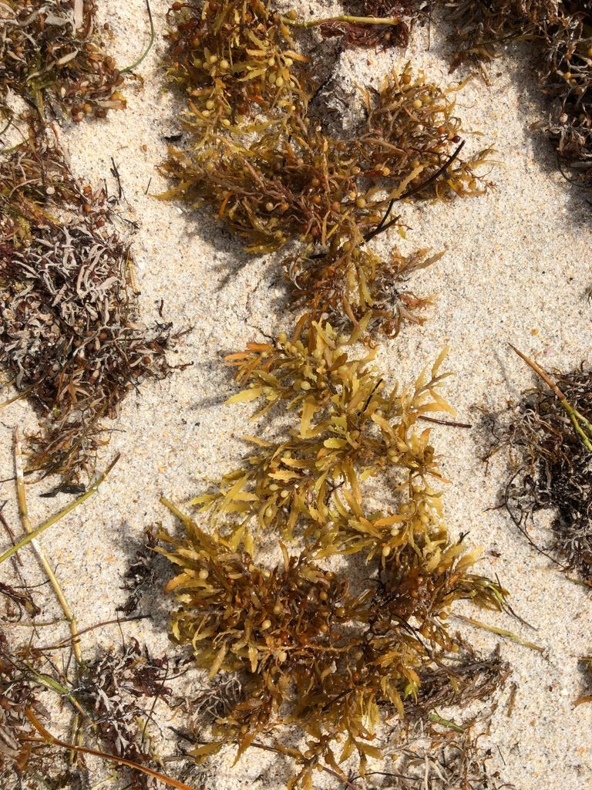
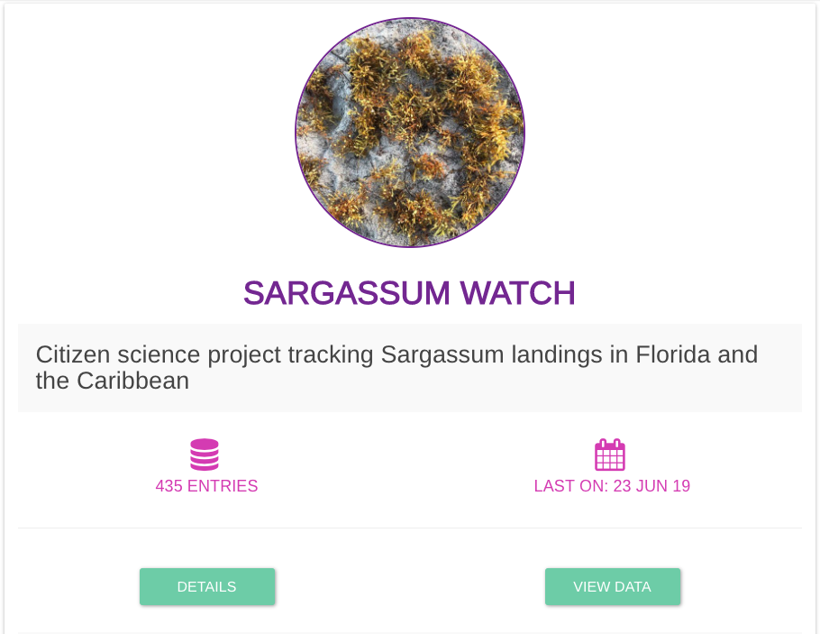
Target Group/Epicollect5 Approach
On-site observation
Epicollect5
(FREE mobile app for in situ observations)
OPEN Database
Notes:
Anyone can download the app!

Slide 15
Very high Sargassum
High Sargassum
Moderate Sargassum
Low Sargassum
Very low Sargassum
(Accumulation categories from Collado-Vides et al. 2018)
Notes:
N = 3-8 per day, depending on seasonality of groups.

Slide 16
A
A
B

Slide 17
Using target groups reduced the geographical variability, but now we have a standardized time series data collection

Slide 18
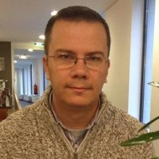
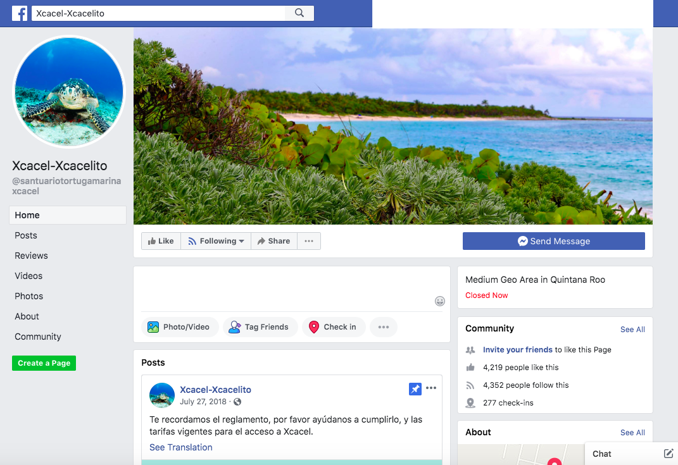
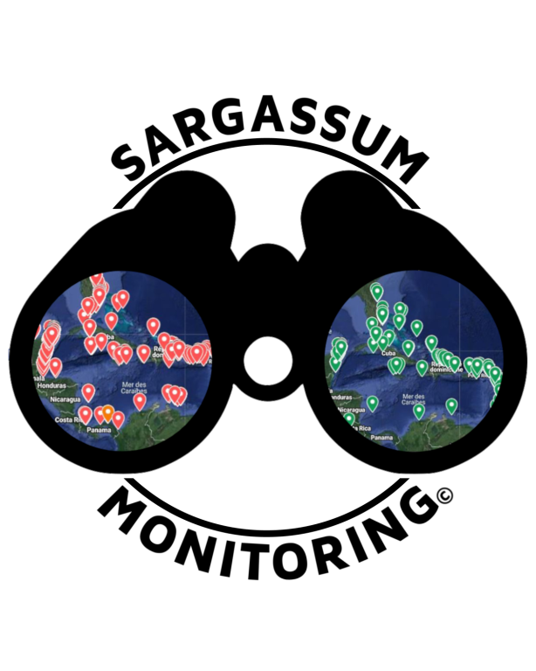
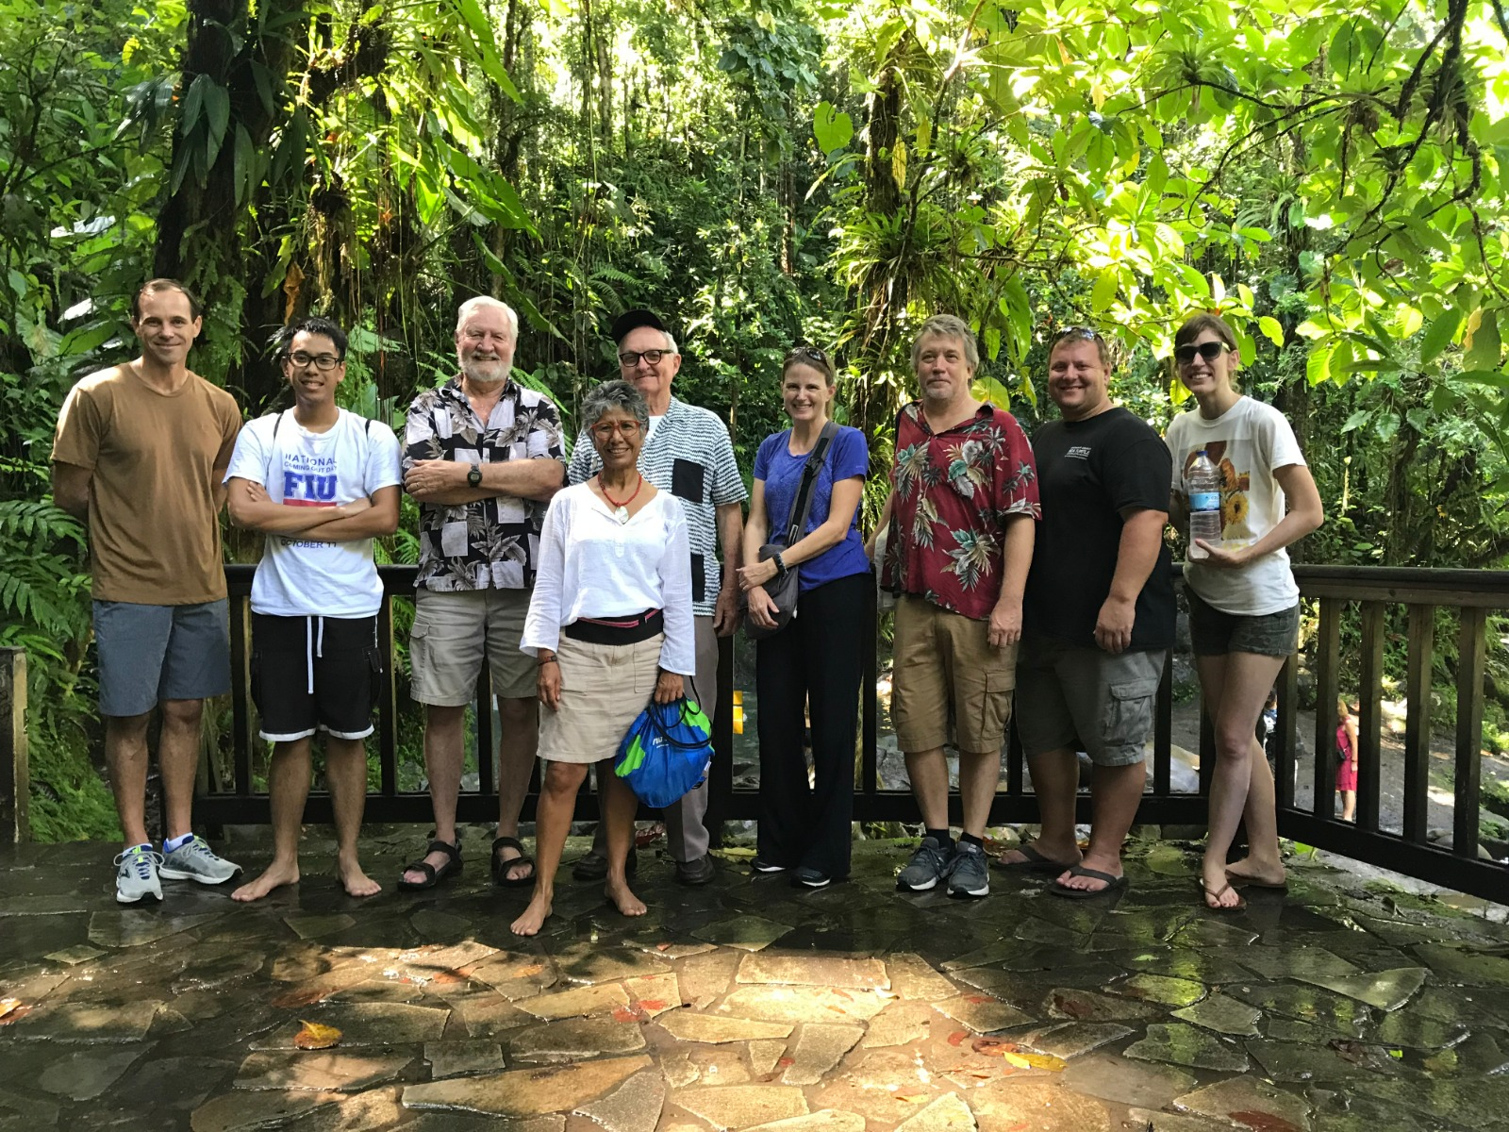
Collaborations and syntheses are underway!
Dr. Javier Arellano-Verdejo (Computer Scientist at ECOSUR)
Sargassum Monitoring ©
Sarg’Net Sargassum Conference 2019
Collective View (ERIS Chetumal)

Slide 19
What to learn from this?
Citizen Science is a fairly new frontier of science.
Most of our current target groups we collaborate with are in Florida. (We want to expand in the Caribbean!)
We need to start conversations about the kind of information we’ll need, level of accuracy, the goals and approaches of each program, and how we’ll organize that data.

Slide 20
Acknowledgments

